Slide 1


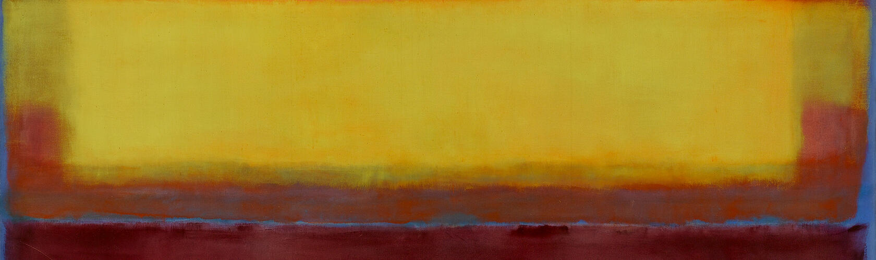

Slide 2
Reflection Activity – Colour As Code
Instructions: Choose one artist from the “Colour as Code Theory” PowerPoint to reflect on. Your options are: Ai Weiwei, Mark Rothko, Spencer Tunick, Robyn Backen, Patricia Piccinini, Sol LeWitt, Olafur Eliasson.
Answer the following questions based on how your chosen artist uses colour as a visual code to create meaning in their work
Reflection Questions:
How does your chosen artist use colour as a visual code to communicate meaning, mood, or message in their work? Think about how their colour choices guide how the viewer feels or understands the work.
In what ways does the cultural, social, or political context shape the meaning of colour in this artist’s practice? Consider whether colour is used to challenge ideas, reference tradition, or reflect on current issues.
What do you think your artist’s inquiry question could have been based on their use of colour? Write one open-ended question that might have guided the artist’s exploration.

Slide 3
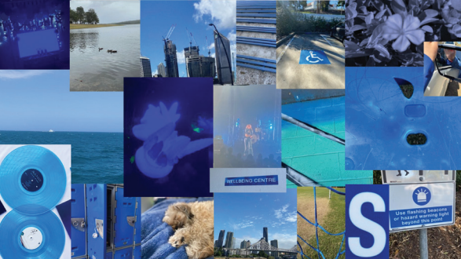
PRACTICAL ACTIVITY PART A
Task: Colour as Code – Create a visual collection that explores how one colour can carry multiple meanings depending on its context.
Objective: To investigate how colour operates as a symbolic code, shifting meaning based on environment, object, and cultural association.
Instructions:
Choose one colour (e.g. red, blue, yellow).
Photograph or 20 objects or environments where that colour is present.
Present your findings as a digital collage or printed visual board that maps the colour’s emotional, cultural, or symbolic shifts. (Hint use a collage app such as PicCollage)
Formal Context: Explore how colour functions visually through hue, saturation, and placement. Think about how colour creates mood, focus, or contrast, and how it changes meaning depending on what it’s paired with in each image.
Cultural Context: Consider how colour meanings shift across cultures and contexts. Reflect on how your chosen colour is used in traditions, symbols, or everyday life to communicate identity, values, or social messages.

Slide 4
Researching: How did you react to stimulus?
Insert clear image of artwork
Crop the image to frame the work (nothing in the background)
Developing: How did you generate solutions to visual problems? Insert a photograph/s detail of the artwork below
Reflecting: How did you consider ideas and information, media techniques and processes?
Evaluate: How successful was the experiment? Why?

Slide 5
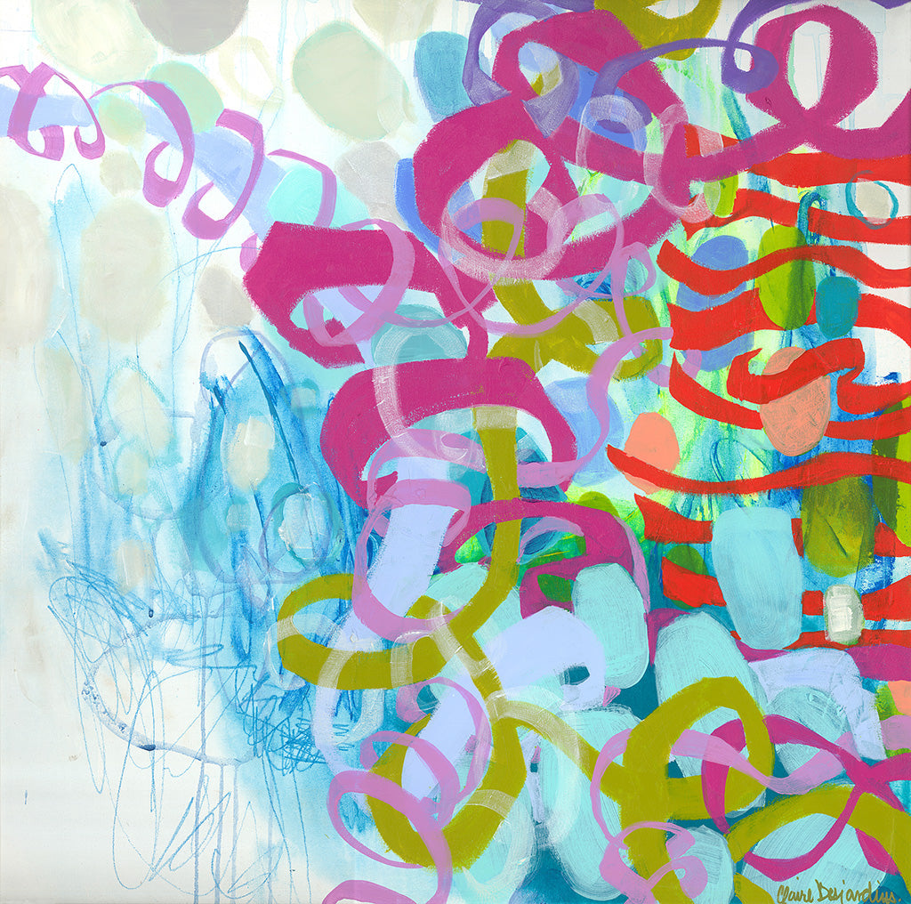
PRACTICAL ACTIVITY PART B
Task: Create an abstract artwork using only colour and shape (no text or representational imagery) to express a personal experience, place, or feeling.
Objective: To explore how colour and form can visually code emotion and memory through abstraction.
Instructions:
Choose a powerful memory (joyful, sad, or significant).
Plan how to communicate this experience using colour, shape, and composition only.
Use any combination of acrylic, watercolour, collage, or mixed media.
Focus on how arrangement, layering, and contrast can convey mood or meaning.
Formal Context: Use colour, shape, and spatial arrangement to create visual harmony, tension, or rhythm that communicates emotion.
Cultural Context: Consider how personal or cultural associations with colour can influence the way your artwork is read and interpreted.

Slide 6
Researching: How did you react to stimulus?
Insert clear image of artwork
Crop the image to frame the work (nothing in the background)
Developing: How did you generate solutions to visual problems? Insert a photograph/s detail of the artwork below
Reflecting: How did you consider ideas and information, media techniques and processes?
Evaluate: How successful was the experiment? Why?

